Slide 1

New Feature Overview:
Multi-Select OptionSets
DYNAMICS 365 v9

Slide 2

Mitch Milam
mitch@xrmcoaches.com
@mitchmilam
linkedin.com/in/mitchmilam
youtube.com/xRMCoaches
Subscribe!

Slide 3
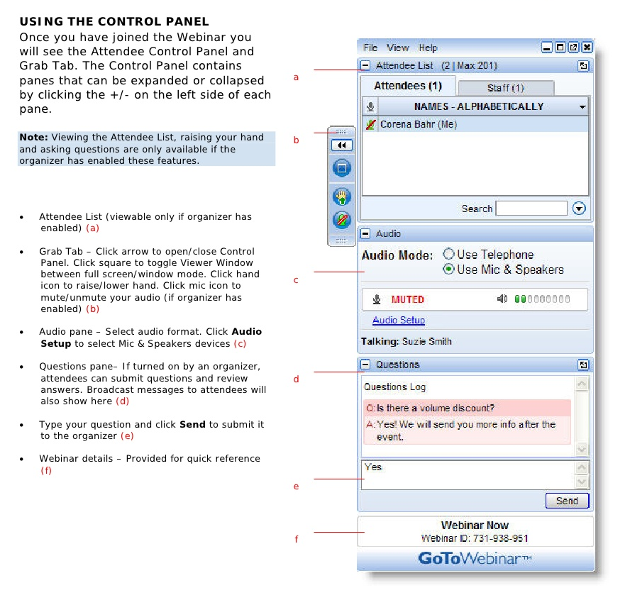
Webinar Housekeeping

Slide 4
Agenda
When
Where
Why
Technology
Tools

Slide 5
Overview
General Availability
  1st week of October

Slide 6
New Feature
Overview

Slide 7
Demo

Slide 8
Questions?

Slide 9
Thank You

